Slide 1
Optical network virtualization
Chapter 17
Springer Handbook
of Optical Networks

Slide 2
Index:
Introduction
All about SDN
API
What’s the NFV
Programmable Interfaces in Optical Networks
Network resource virtualization
Optical Network Substrate Virtualization
VON
Breadth first search algorithm
Survivability
Control Plane Virtualization for GMPLS and OpenFlow Environments

Slide 3

As a service
Infrastructure
network
shared
Compute:
GPU
HPC
IaaS
Hourly/ monthly
Storage:
Block
File
object
No contract
Self service

Slide 4
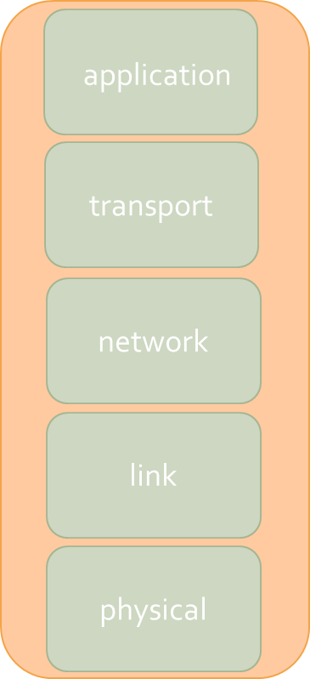
Network virtualization
Improve the scalability
Improve the efficiency
Ossification Problem
network virtualization has been propounded as a diversifying attribute of the future inter-networking paradigm

Slide 5

Virtualization in general case:
Kind of software
Pool the resources from physical server and allocate them to your virtual environment
VM migration
VM
VM
VM
hypervisor
hypervisor
host
host

Slide 6
SDN:
App
App
APP
SDN consist of this 4 innovation:
1. Separation of the control and data planes
2. Centralization of the control plane
3. Programmability of the control plane
4. Standardization of application programming interfaces (APIs)
…
Operating system
CPU
storage
memory
network

Slide 7
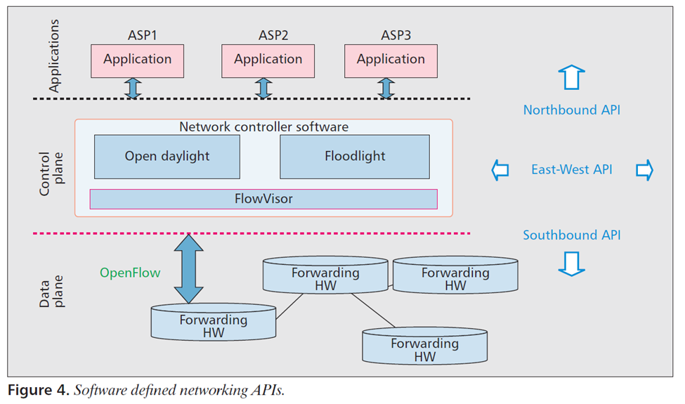
Create an abstraction view of the network
controller
Global view of all forwarding devices
Way to communicate packet forwarding construction to them

Slide 8
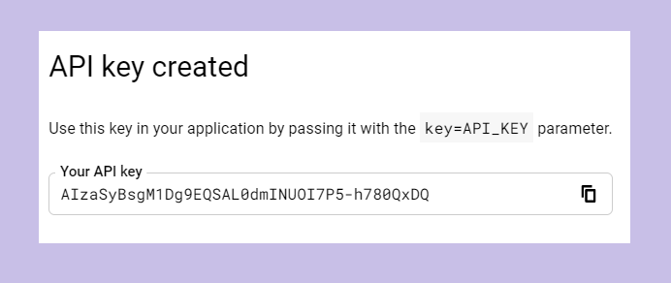
API:
Access data
Example of API key:
Hide complexity
Extend functionality
security

Slide 9
APP
APP
APP
Northbound API
CONTROLLER
Southbound API
Network forwarding devices
Router#1
Router#2
Router#3

Slide 10
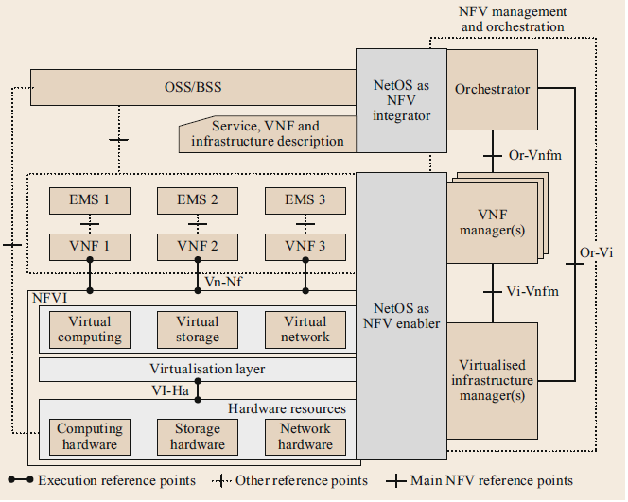
NFV
switches
Load balancer
,…
routers
firewalls

Slide 11
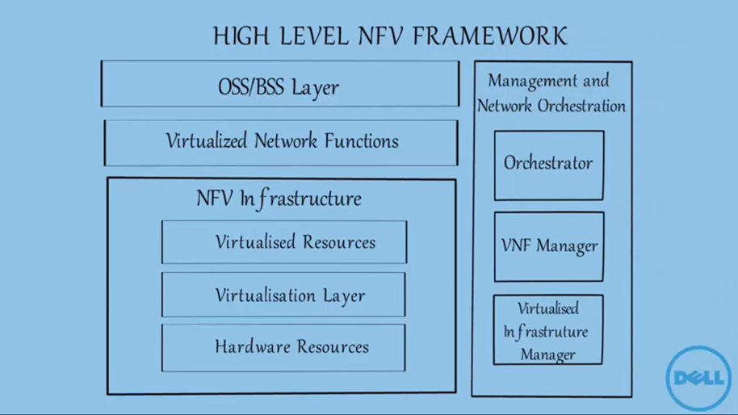
Dealing with fault/Network management ,..
Customer / billing /revenue management,…
Responsible for policy management,
KPI management,..
Outcome of NFV
implementation
Manage the life cycle of VNF instances
Manage the interaction of VNF with NFVI resources

Slide 12
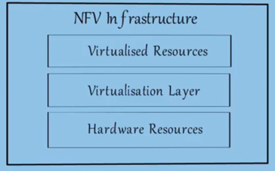
Virtual network
Virtual resources
Virtual storage
Decouple hardware and software
Computing resources
Servers, rams
Storage resources:
NAS
Network resources: routers, switches firewalls

Slide 13

Element Management System (EMS) is responsible for the functional management of VNF.
EMS
EMS
EMS
VNF
VNF
VNF
VNF examples:
Vrouters
Vfirewalls
VIMs:
VNF
VNF
SERVICE CHANING
VNF
VNF

Slide 14
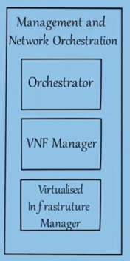
Manages the lifecycle of network services
Manages the lifecycle of VNF instnaces and charge for :initialize, query, scale, terminate of VNF instances
Controls and manages the interaction the VNF with NFVI computer storage and networks resources

Slide 15
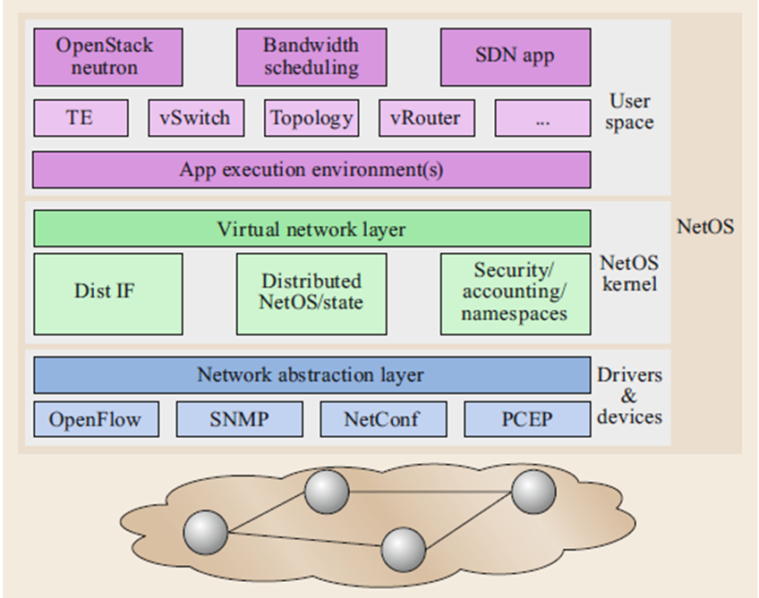
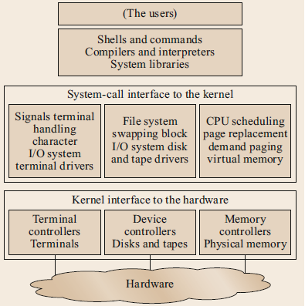
NetOS
UNIX system

Slide 16
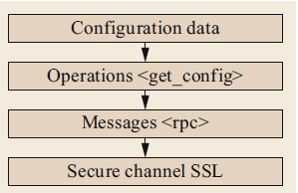
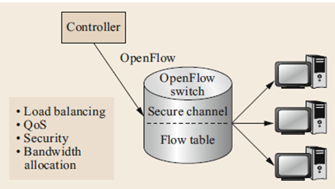
Programmable Interfaces in Optical Networks
Interfaces
Topology interface
BGP-LS
REST API
Provisioning interface
NET CONF
PCEP
REST API
OpenFlow

Slide 17

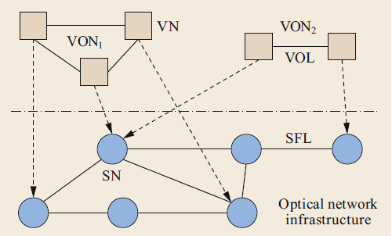
Resource aware
Energy aware
PLI aware
WDM
EON
SDM

Slide 18
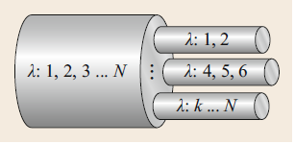
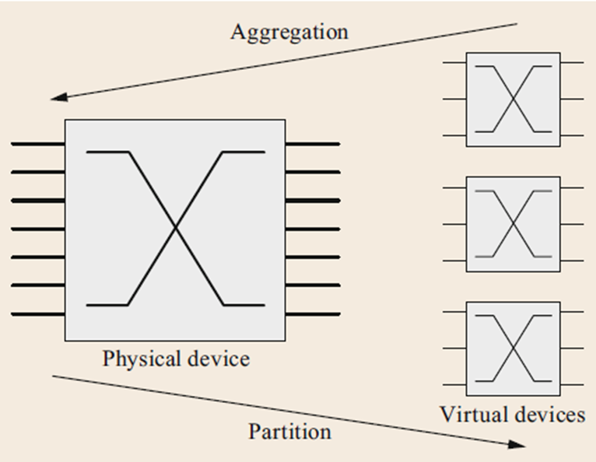
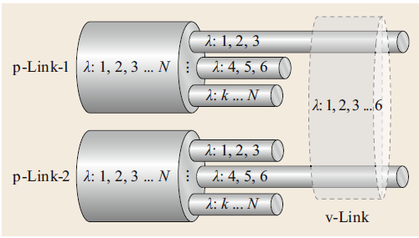
Optical Network Substrate Virtualization
Optical switch
Fiber link

Slide 19
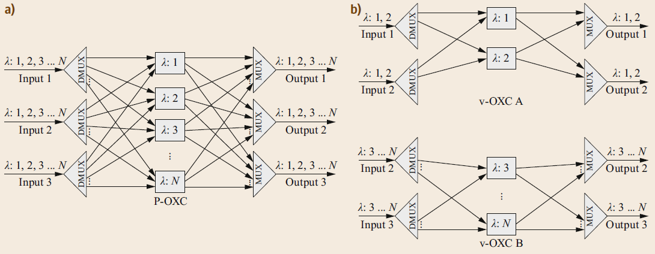

Slide 20
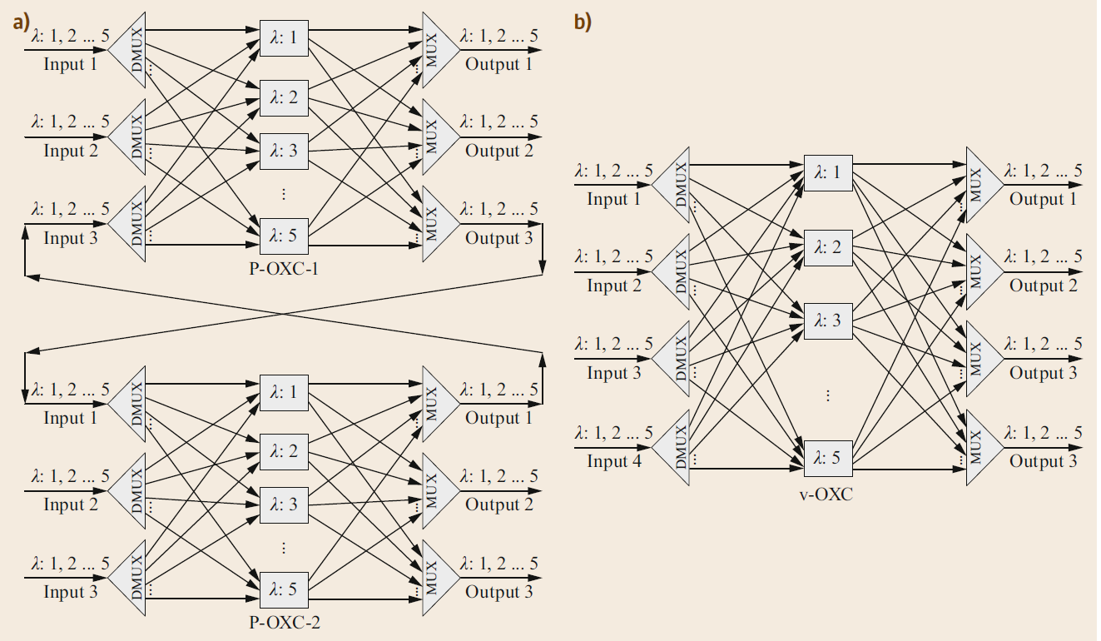


Slide 21
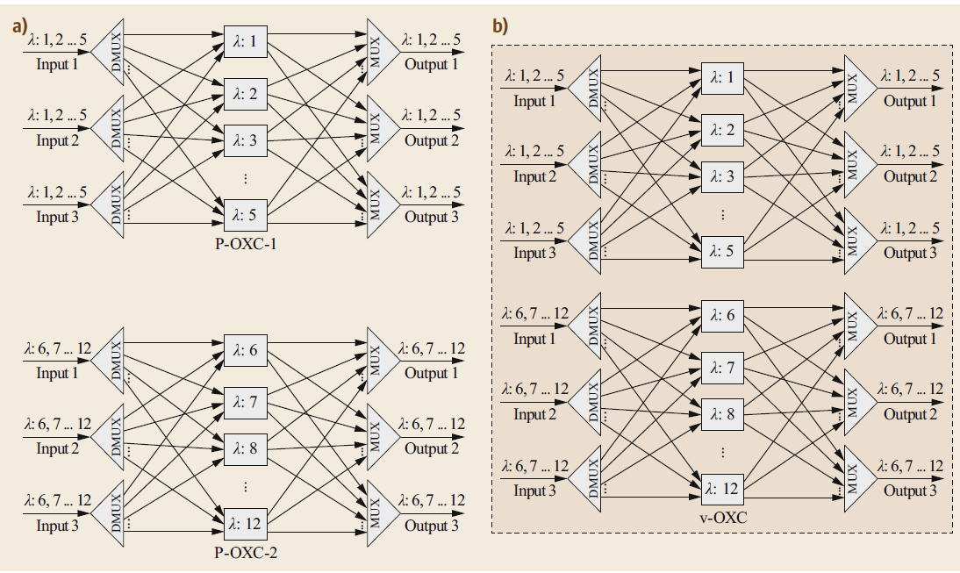

Slide 22
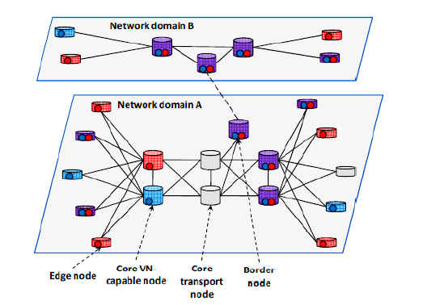
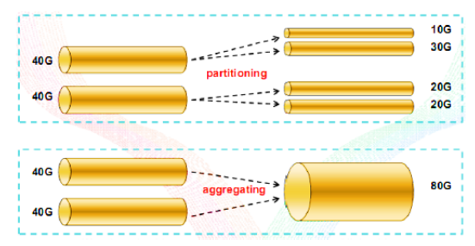
Link virtualization
Node virtualization

Slide 23
features
Autonomy
Isolation
Network abstraction
Topology awareness
Performance
Mobility
Key Issues for Virtual Optical Networks:
Coexistence of Virtual Networks
Dynamic Reconfigurability
Network Level Operability

Slide 24
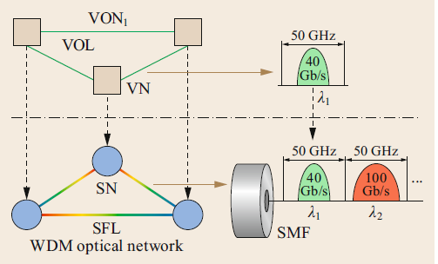
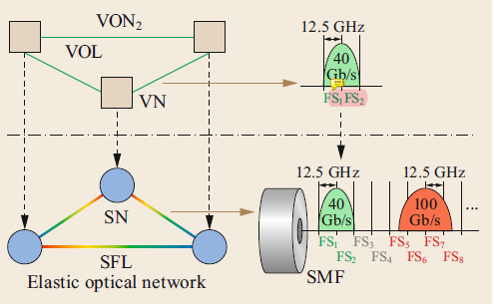
VON
VON over WDM Optical Networks
VON over Elastic Optical Networks (EONs).

Slide 25
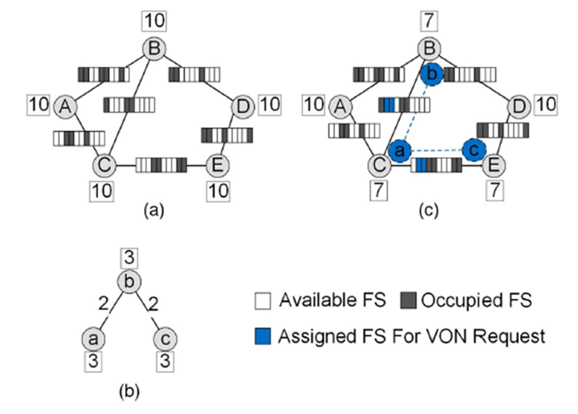
VONE Models
SON :undirected or directed graph
VONR: undirected or directed graph
Transparent VONE
ILP formulation
Node mapping
Link mapping
Spectrum non-overlapped, continuity and contiguity constraints

Slide 26
Breadth first search algorithm
queue
1
6
6
5
1
7
0
7
3
2
5
3
2
0

Slide 27
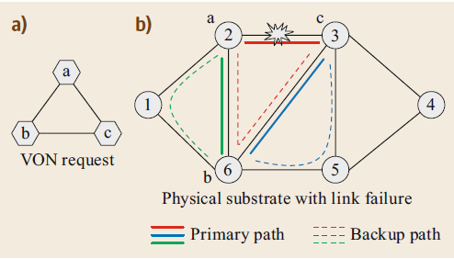
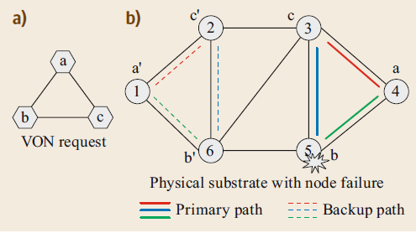
SURVIVABILITY
Link Failure
Node Failure

Slide 28
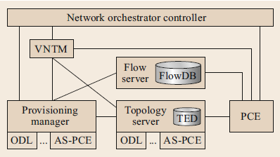
Network Function Virtualization in Optical Networks
Components of architecture
NFV Orchestrator
VNF manager
Integrate cloud
Network orchestrator
The Network CRUD Mechanism.
Integrated Cloud and Network Orchestrator
Multidomain SDN Orchestrator
The VM CRUD Mechanism
VM Migration
The VON CRUD Mechanism.
VNF Manager
NFV Orchestrator

Slide 29
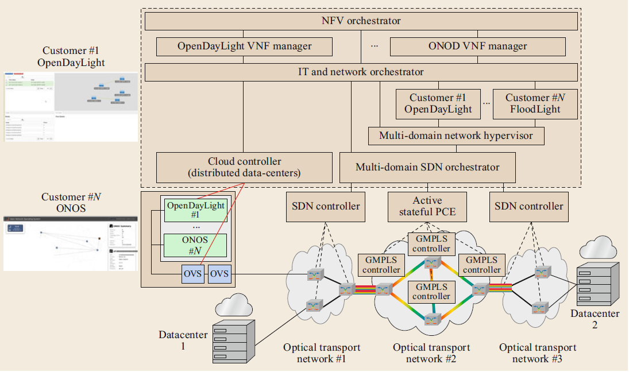
Control Plane Virtualization for GMPLS and OpenFlow Environments

Slide 30
